Slide 1
From Raw Read Data to Differential Gene Expression Analysis
RNA-Seq Pipelines and Computational Analysis – 2020 Workshop
Notes:
1

Slide 2
Overview
RNASeq bioinformatics: why?
Bioinformatics NGS terminology
RNASeq bioinformatics pipeline

Slide 3
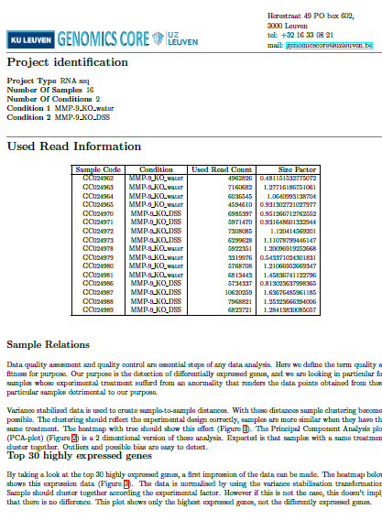
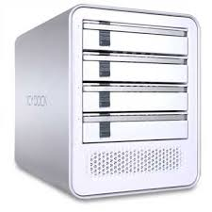
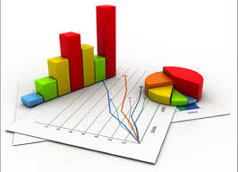
RNA Sequencing
A typical RNA-Seq analysis at the Genomics Core delivers:
10 report files: differentially expressed genes, reads quality report, counting report,…
3GB of raw and analyzed data: Fastq, BAM, counts, normalized counts, gene expression files, heatmaps…

Slide 4

1. Results Interpretation

Slide 5
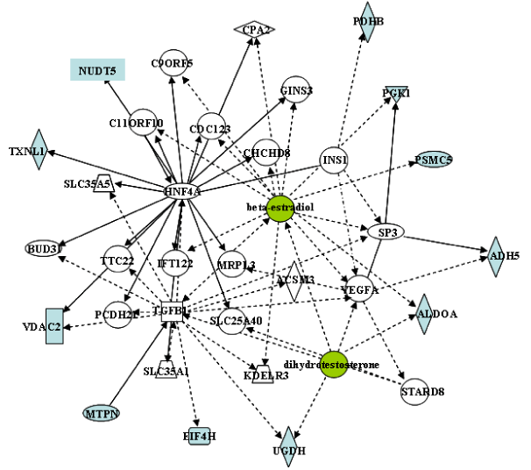
2. Downstream Analysis
Reviewer: “The transcriptional and proteomic profiling experiments propose some interesting followup pathways for further analysis that may shed light on the mechanisms underlying these conditions. “

Slide 6
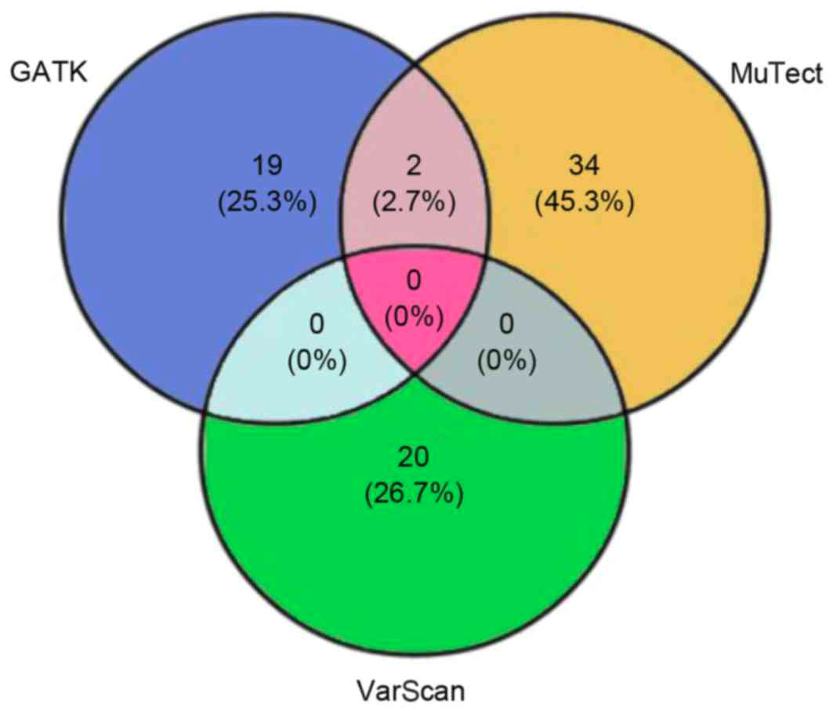
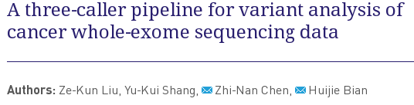
3. Data Re-analysis

Slide 7
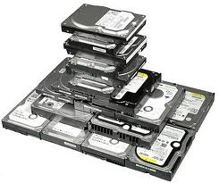
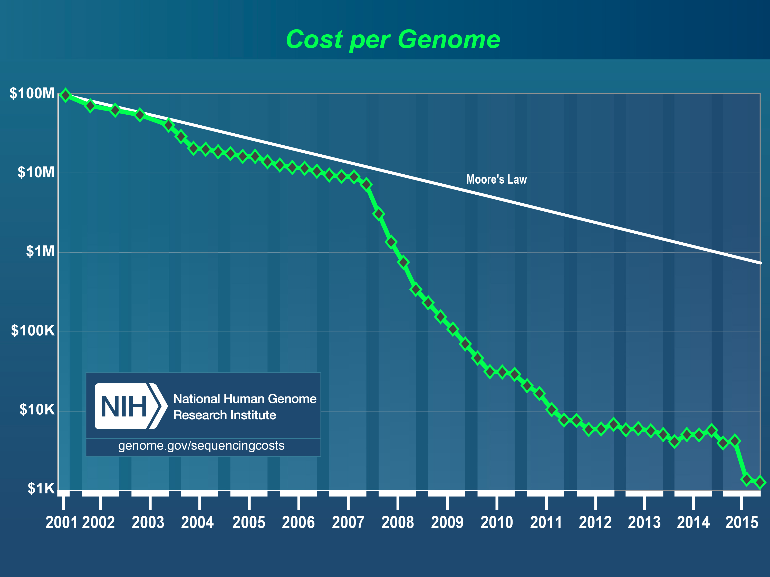



4. Costs Saving

Slide 8
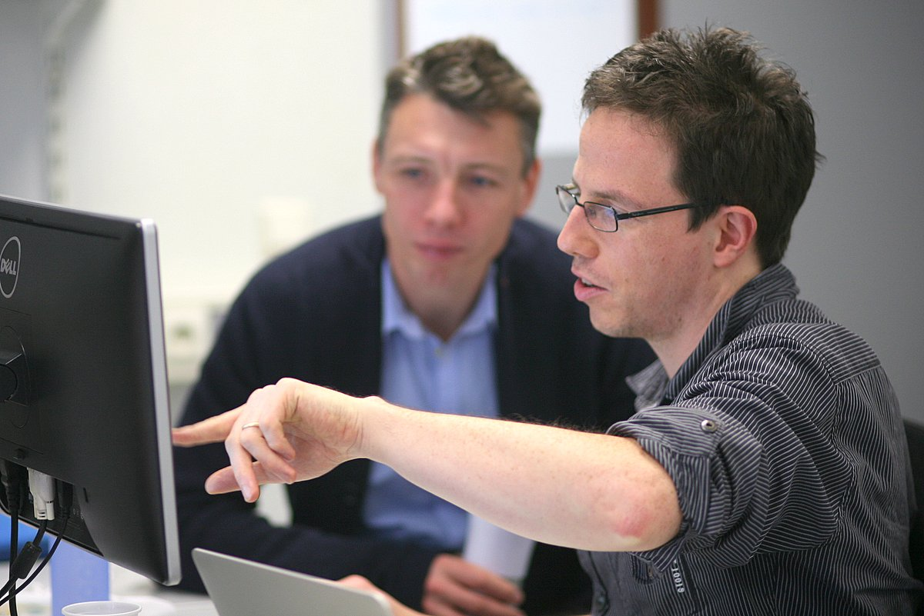
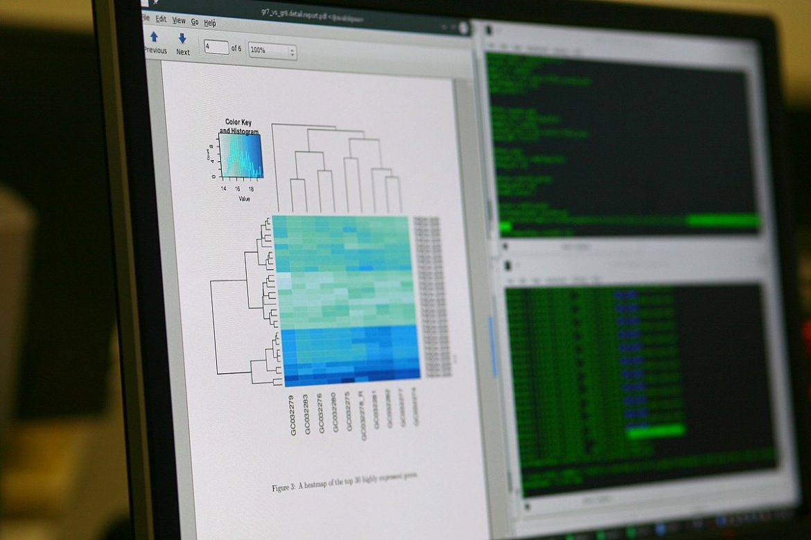
4. Bioinformatics is Interesting (and a valuable skill)

Slide 9
Overview
RNASeq bioinformatics: why?
Bioinformatics NGS terminology
RNASeq bioinformatics pipeline

Slide 10
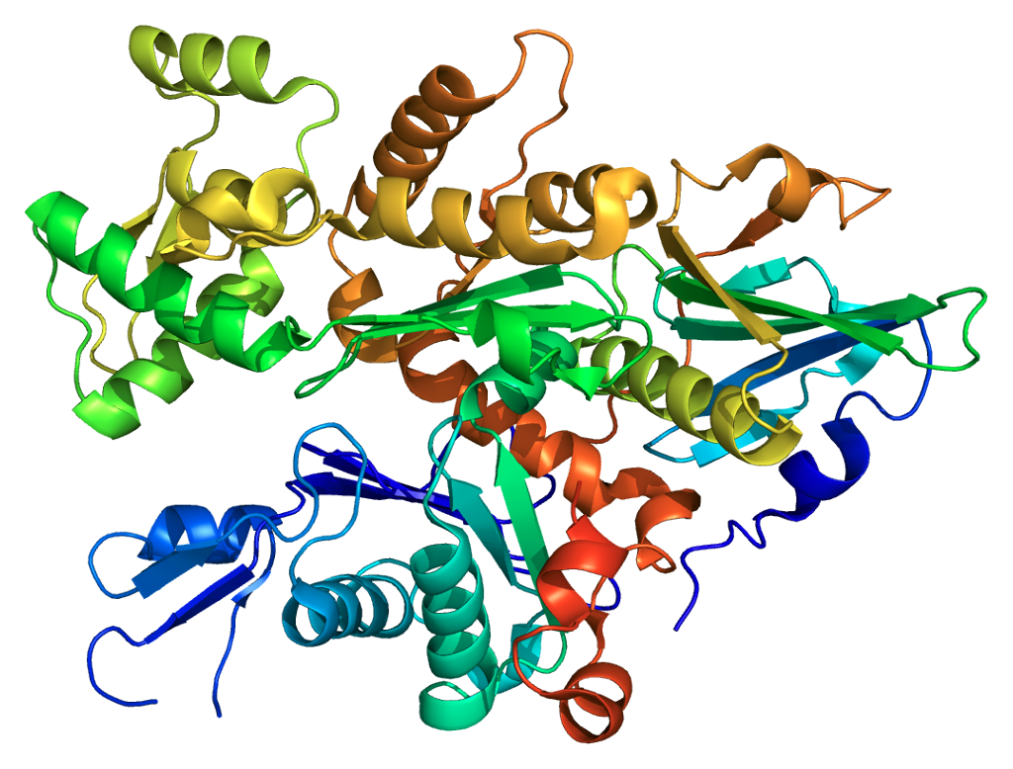
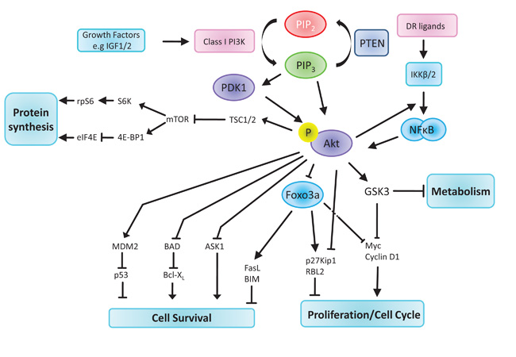
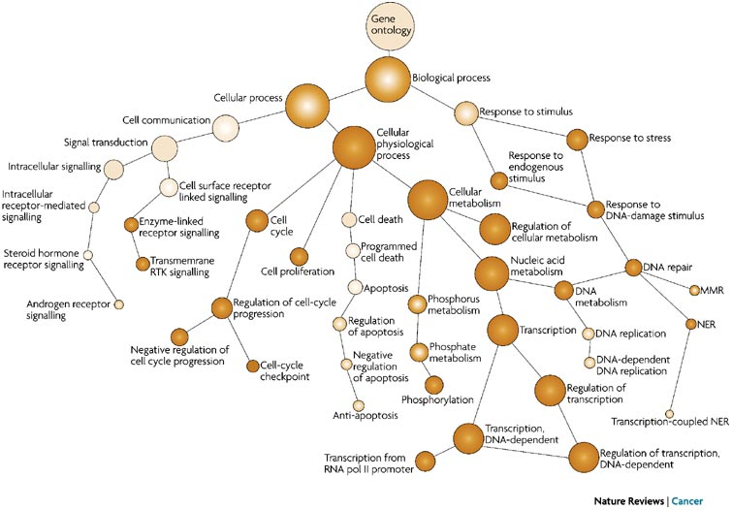
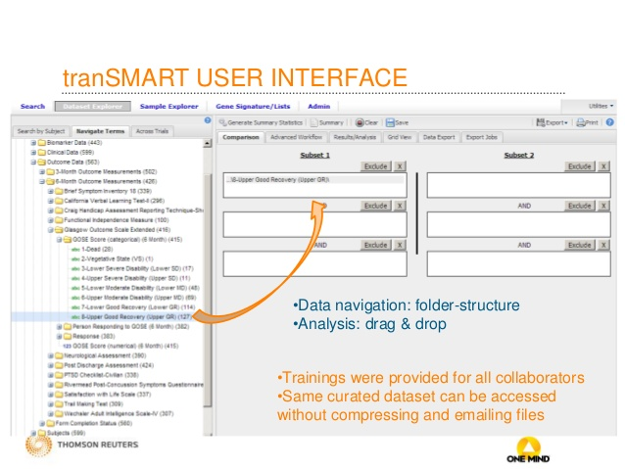
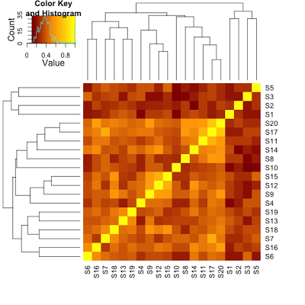

Bioinformatics...
...is a broad field

Slide 11
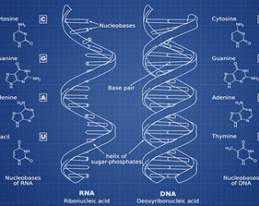
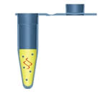
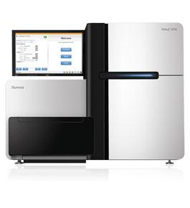

NGS Bioinformatics
Experimental Design
Sequencing
Follow up and support
Library Preparation
Bioinformatics

Slide 12
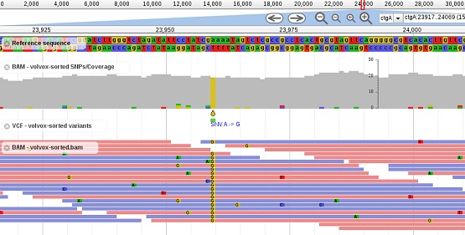
NGS Bioinformatics
NGS bioinformatics: interpretation and analysis of NGS data using informatics tools

Slide 13
A day in bioinformatics
Poly-A tail
Fastq
Ontology
Fragments cluster
Xenograft Murine infiltration
Hadoop
Flow Cell
Demultiplexing
VCF File
Ortholog gene
BAM
Negative binomial distribution
Cluster
snRNA
Bonferroni Correction
Barcode

Slide 14

NGS Terminology: Pipeline, Sequencing
Sequencing
Demultiplexing
Assembly
DNA (RNA)
Fastq(c)
Alignment
DNA
RNA
Variant Calling
Counting
Individual Studies
Population Studies
Differential Expression
Relative Expression

Slide 15
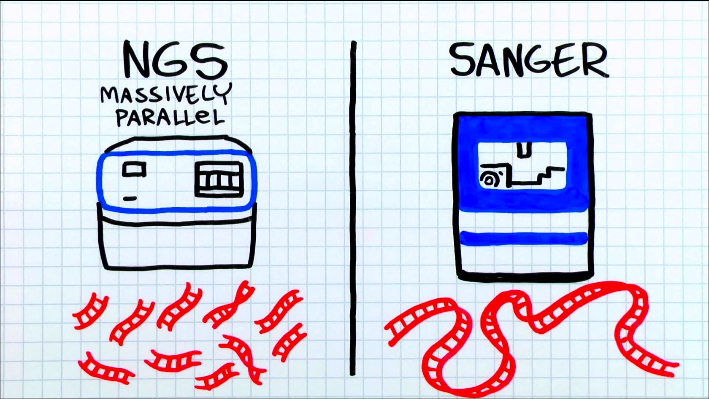
NGS Sequencing
DNA sequencing is the process of determining the precise order of nucleotides within a DNA molecule. It includes any method or technology that is used to determine the order of the four bases—adenine, guanine, cytosine, and thymine—in a strand of DNA.
NGS sequencing
Shotgun sequencing
Massively parallel sequencing
Deep Sequencing
NGS platforms perform sequencing of millions of small fragments of DNA in parallel.
Image:Thermo Fisher Scientic

Slide 16
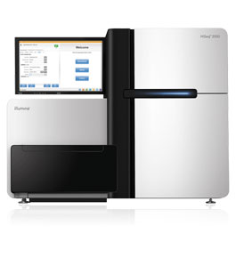

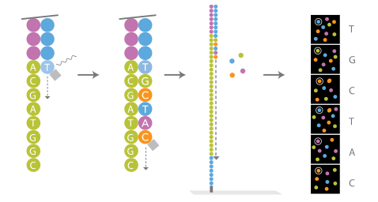

From DNA molecules to digital reads

Slide 17
From DNA molecules to digital reads
DNA Library
Reads

Slide 18
NGS Terminology: Demultiplexing
Sequencing
Demultiplexing
Assembly
DNA (RNA)
Fastq(c)
Alignment
DNA
RNA
Variant Calling
Counting
Individual Studies
Population Studies
Differential Expression
Relative Expression

Slide 19

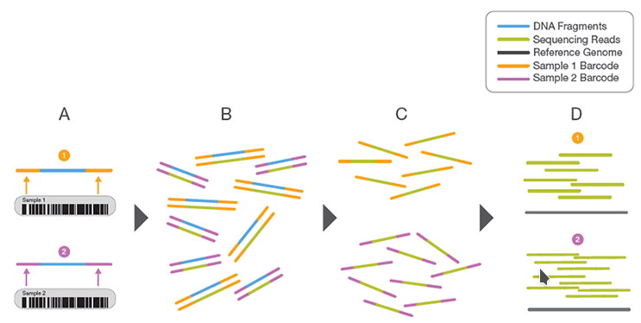
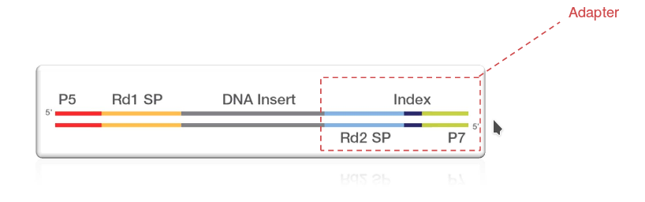
(De)Multiplexing
Multiple samples can be pooled together or multiplexed into one or more flowcells

Slide 20
NGS Terminology: Fastq
Sequencing
Demultiplexing
Assembly
DNA (RNA)
Fastq(c)
Alignment
DNA
RNA
Variant Calling
Counting
Individual Studies
Population Studies
Differential Expression
Relative Expression

Slide 21
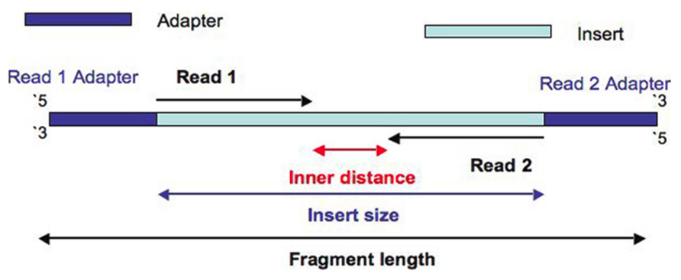
Reads and Fragments
Fragment: biological entity
Read: bioinformatic concept
Fragment: the DNA template + adapters that were loaded on the sequencing machine (is not completely sequenced)
Read: a raw sequence originating from a sequencing machine
Single Read: Sequencing only from one end
Paired-end: Sequencing starting from both ends of the insert

Slide 22
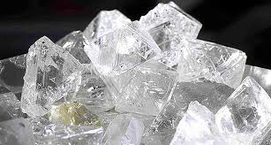
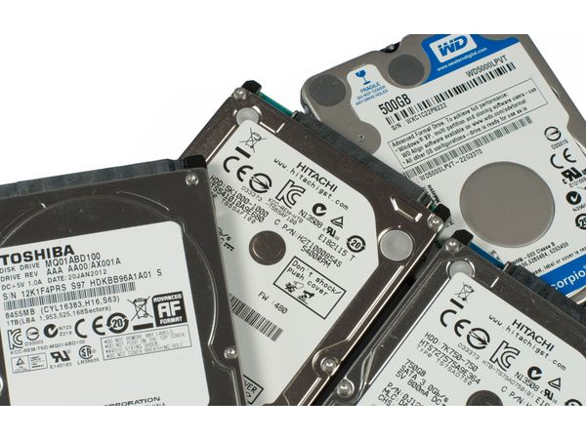
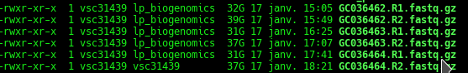
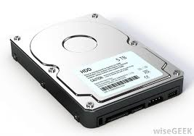
Fastq format & Files
The result of demultiplexing is one (or two for paired-end reads) fastq files containing raw reads
Fastq files are human readable (not binary) text files.
Referred as raw data.
Fastq files are the raw diamonds of any NGS bioinformatics project
Fastq files are often compressed using zip or gunzip

Slide 23
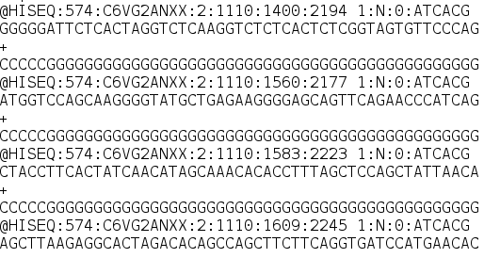
Reads and Fastq Format
What is a “read”?
A raw sequence (ordered collection) of nucleotides names A,C,G,T, or N.
RNASeq: Typically 51 characters long.
Read lenght is experiment-dependent
Fastq format?
Plain-text file, where each read and complementary information occupies 4 consecutive lines
Typical size 500M compressed (Illumina Truseq Stranded), 2000M unzipped
\
Counting reads in fastq files: zcat my.fastq.gz | echo $((`wc -l`/4)) : 12.748.143
Sequencing depth (RNASeq): The total number of sequences generated for a sample.

Slide 24
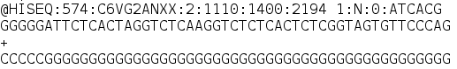
Raw Reads
1
2
3
4
Line 1: Read identifier and is followed by a sequence that
Unique, platform dependent
Begins with a '@' character
@HISEQ:574:C6VG2ANXX:2:1110:1400:2194 1:N:0:ATCACG
Line 2: Raw sequence of nucleotides: read
Line 3: begins with a '+' character and is optionally followed by the same sequence identifier.
Line 4: Quality values for the sequence in Line 2
Instrument
Run, flowcellID, lane, tile, pos, read, filter, control
Index

Slide 25
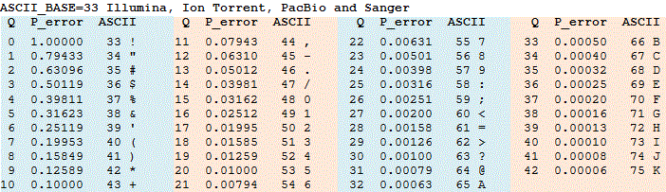
Raw Reads: Base Calling Quality
A quality score (Q-score) is a prediction of the probability of an error in base calling.
It serves as a compact way to communicate very small error probabilities
P = 10^(–Q/10)
Q = –10 log10(P)

Slide 26
Raw Reads: Base Calling Quality
Base: G
Quality: C
ASCII: 67
Q: 34
P: 0.00040
Base: G
Quality: G
ASCII: 71
Q: 38
P: 0.00016

Slide 27
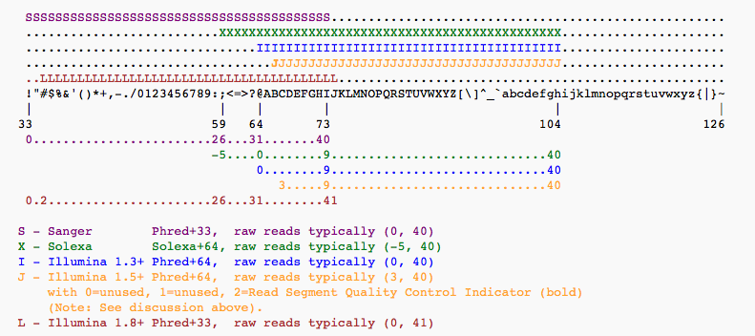
Raw Reads: Base Calling Quality

Slide 28
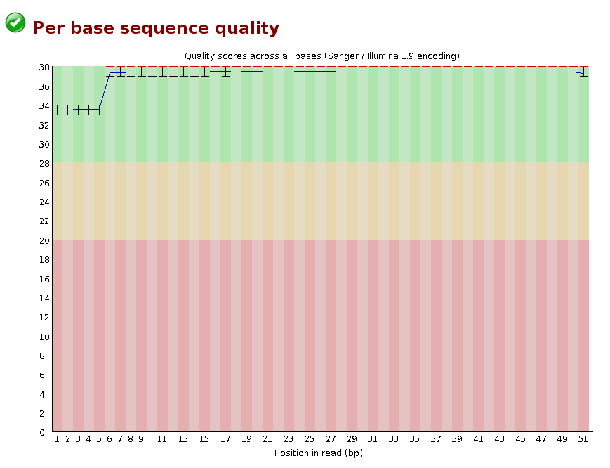
FastQC Report

Slide 29
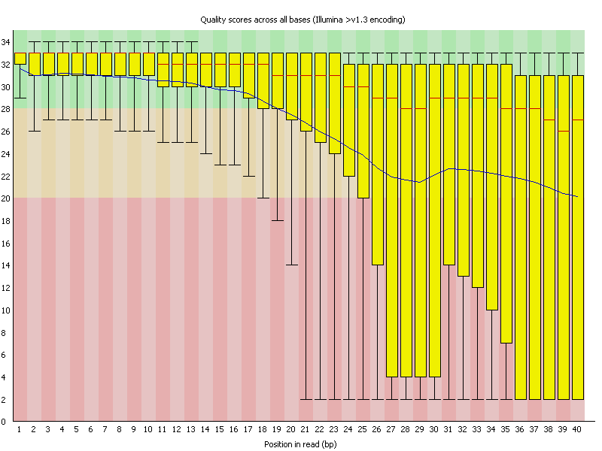
FastQC Report

Slide 30
NGS Terminology: Alignment/Mapping
Sequencing
Demultiplexing
Assembly
DNA (RNA)
Fastq(c)
Alignment
DNA
RNA
Variant Calling
Counting
Individual Studies
Population Studies
Differential Expression
Relative Expression

Slide 31


Slide 32
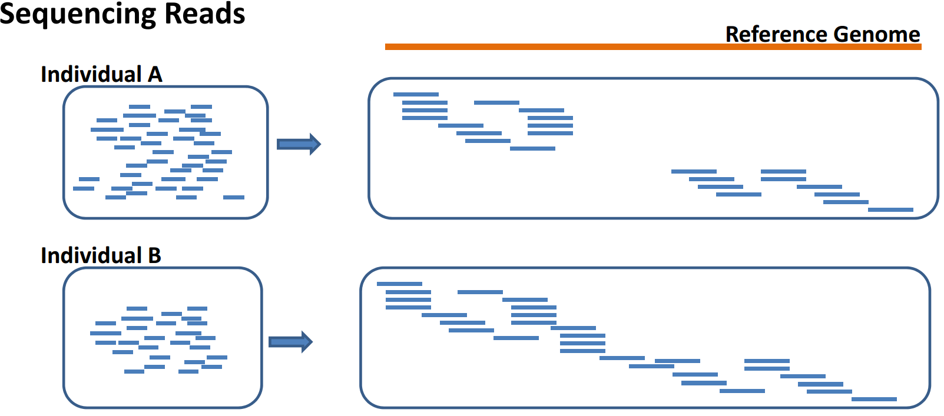
Mapping to Reference Genome
Mapping refers to the process of aligning short reads to a reference sequence, whether the reference is a complete genome, transcriptome, or de novo assembly.
--http://sfg.stanford.edu/mapping.html

Slide 33
Mapping & Alignment
Reference Ch1:
1234567890123456
ATGGTTACACCATT
Read:
GGTTCA
Possible alignment:
ATGGTTACACCATT
GGTT-CA
Mapping: Ch1-pos3
“Also of note is that by this time the terms “read alignment” and “read mapping” had become interchangeable. The BWA and Bowtie papers both used both terms, as did many other papers.”
https://liorpachter.wordpress.com/2015/11/01/what-is-a-read-mapping/

Slide 34
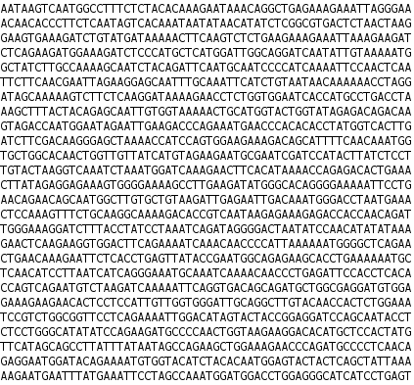
Reference Sequence in Fasta Format
genome.fa human-readable nucleotide sequence
Species dependent
Mouse genome: 2.6GB
Evolves

Slide 35
Overview
RNASeq bioinformatics: why?
Bioinformatics NGS terminology
RNASeq bioinformatics pipeline

Slide 36
NGS Terminology: Demultiplexing
Sequencing
Demultiplexing
Assembly
DNA (RNA)
Fastq(c)
Alignment
DNA
RNA
Variant Calling
Counting
Individual Studies
Population Studies
Differential Expression
Relative Expression

Slide 37
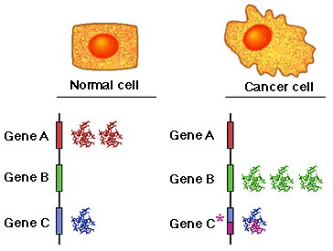
RNA-Seq: Differential Gene Expression
Discover changes in RNA abundance between conditions

Slide 38
RNA-Seq
Sequencer produces millions of reads and a qualification for each base call
What reads have to do with differential expression of genes?
Read count is linearly related to the abundance of the target transcript

Slide 39
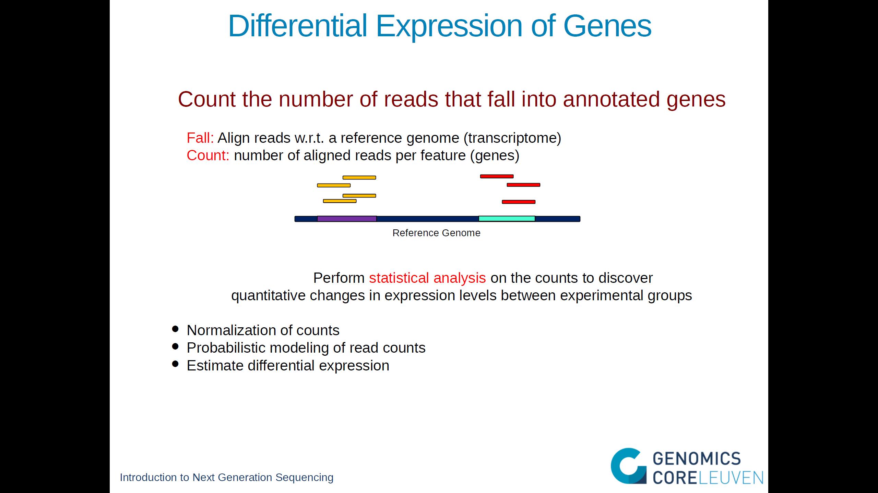

Slide 40
From Raw Reads to Alignment
Reference genome
RNA-Seq reads
Alignment

Slide 41
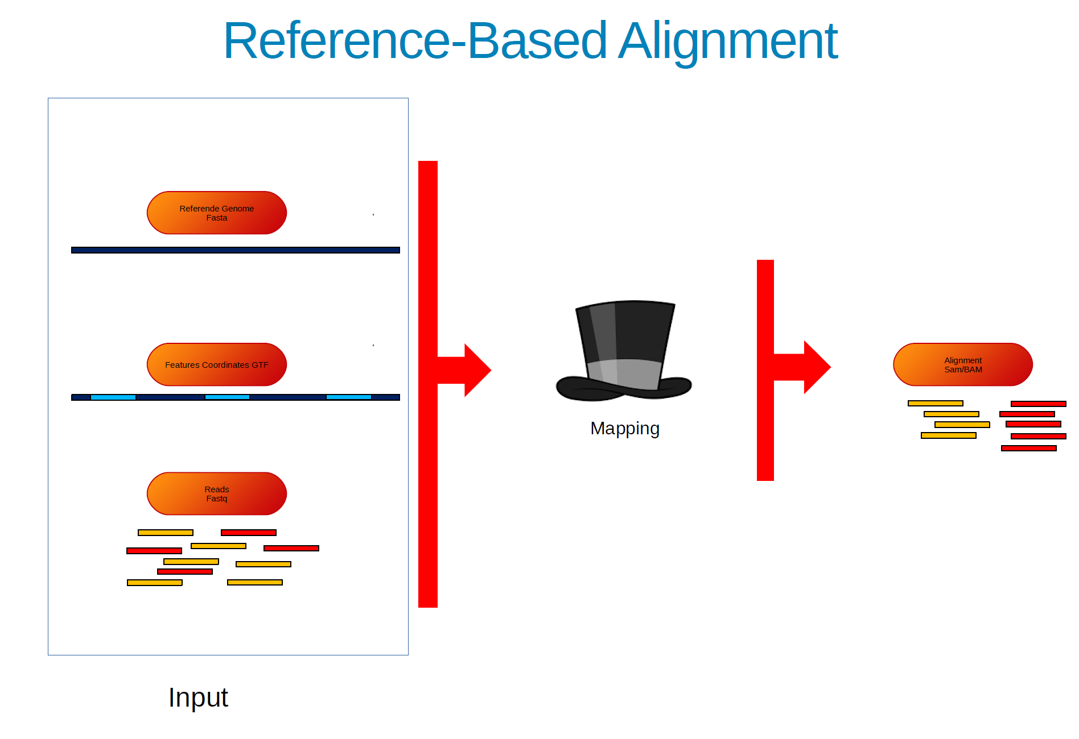

Slide 42


Splice-Aware Alignment
Individual reads are aligned to a reference genome
RNA-seq read alignment differs from standard aligment:
If an RNA-Seq read spans an exon boundary, part of the map will not map contiguosly to the reference
This causes the standard mapping procedure to fail
E2
E3
E1
E2
E3
E4
E5
Gene

Slide 43
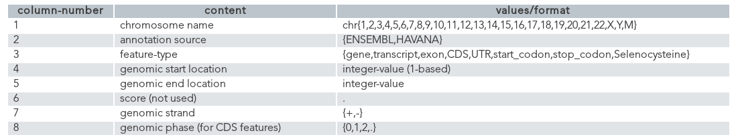
GTF Files: Gene Transfer Format

Slide 44
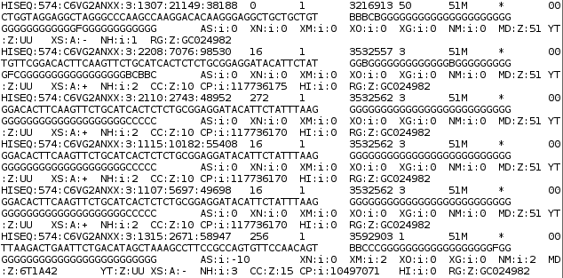
RNA-Seq BAM/SAM
Extract SAM (Sequence Alignment Map) file
Reference Genome
BAM files are machine-readable versions of SAM files

Slide 45
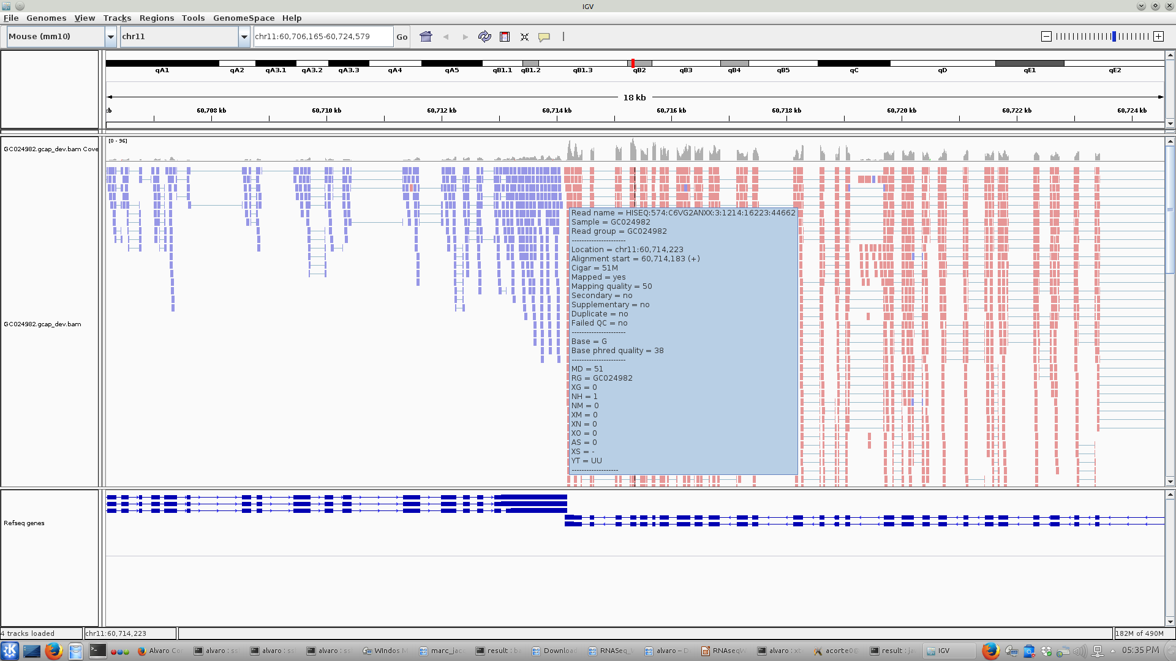
RNA-Seq BAM/SAM

Slide 46
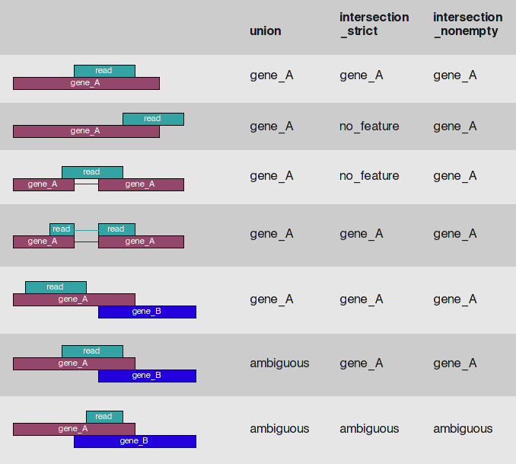
Counting Reads in HTSeq
Method:
Count each read only once
Multi-mapping reads and reads overlapping
multiple features discarded
1,2,3,4
1,2,3
Simon Anders

Slide 47
Counting Reads in HTSeq(*)
(*) Simon Anders, Wolfgang Huber (EMBL)
Resulting table of absolute counts for each sample and feature:
GeneID Sample 1 Sample 2 Sample 3 Sample 4
FBgn0000003 0 0 0 1
FBgn0000008 76 70 88 70
FBgn0000014 0 0 0 0
FBgn0000015 1 2 0 0
FBgn0000017 3564 3150 3072 3334
FBgn0000018 245 310 299 308
But!
1
2
3
4
Library sizes

Slide 48
Normalization of Counts: Impact Library Size
Library 1
Library 2
A bigger library produces more reads...But in slide 3:
“Read Counts is linearly related to the abundance of the target transcript”

Slide 49
Normalization of Counts: Size Factors
Adjust for library sizes to produce count values in a common scale:
Sample 1 Sample 2 Sample 3 Sample4
0.873 1.011 1.022 1.115
Sample 1 Sample 2 Sample 3 Sample4
FBgn0000003 0 0 0 1
FBgn0000008 76 70 88 70
FBgn0000014 0 0 0 0
FBgn0000015 1 2 0 0
FBgn0000017 3564 3150 3072 3334
FBgn0000018 245 310 299 308
Normalized counts
Sample 1 Sample 2 Sample 3 Sample4
FBgn0000003 0.00 0.00 0.0 0.897
FBgn0000008 87.05 69.27 86.1 62.803
FBgn0000014 0.00 0.00 0.0 0.000
FBgn0000015 1.15 1.98 0.0 0.000
FBgn0000017 4082.02 3116.93 3004.5 2991.238
FBgn0000018 280.61 306.75 292.4 276.335
Size factors
1
2
3
4
Library sizes
76/0.873 = 87.05

Slide 50
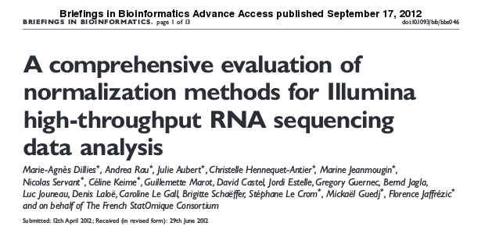
More on Counting and Normalization
Possible extra normalization:
Longer transcripts are more likely to have sequences mapped to their genes
Higher counts, biasing comparisons between transcripts of different lengths.
RPKM - Reads per kilo base per million mapped reads
“based on three real mRNA and one miRNA-seq datasets,we confirm previous observations that RPKM and TC, both of which are still widely in use [40,41], are ineffective and should be definitively abandoned
in the context of differential analysis”

Slide 51
Differential Expression
Statistical test: Decide whether for a given gene, an observed difference in reads counts is significant
Comparison between different biological conditions
Read counts per gene are modeled by a probability distribution

Slide 52
Read Count Distribution Assumption
Method |  | Read Count Distribution Assumption
EdgeR |  | Negative binomial distribution
DESeq |  | Negative binomial distribution
Cuffdiff2 (CuffLinks) |  | Beta negative binomial distribution

Slide 53
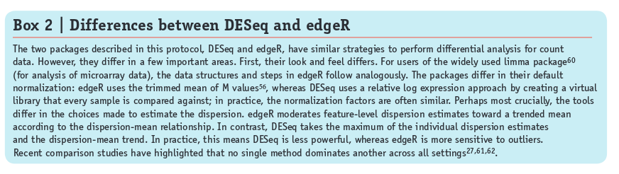
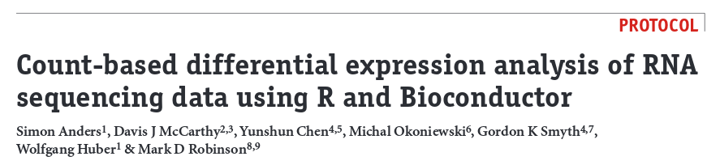
Package Selection
DESeq or edgeR?

Slide 54
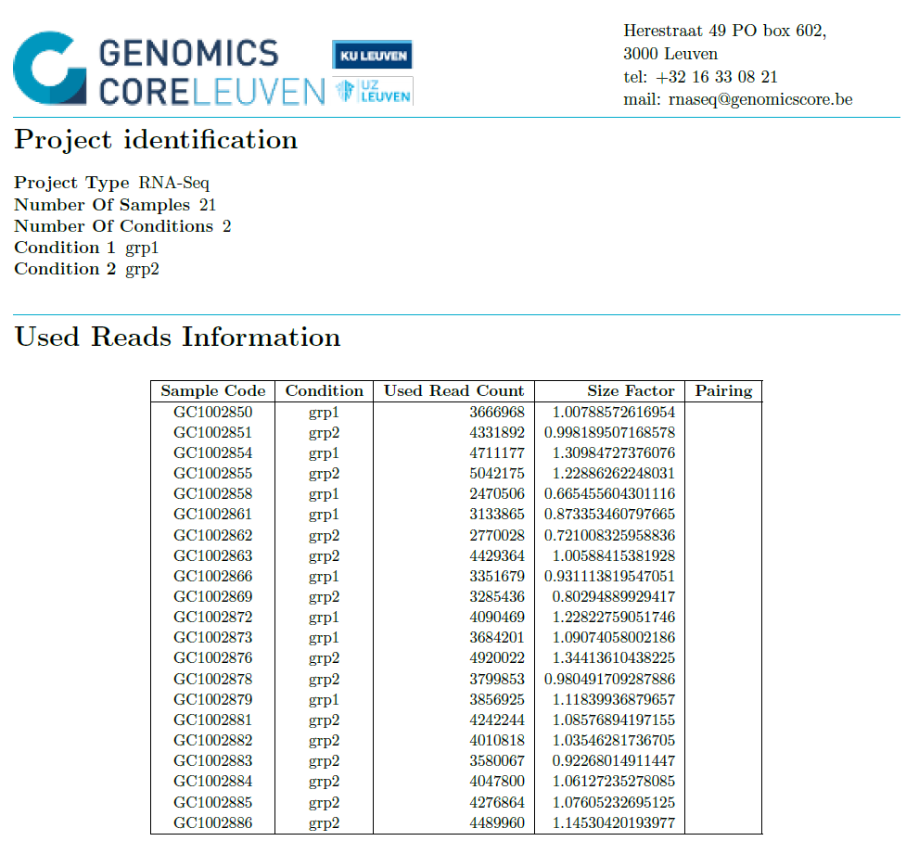
DE Report: Used Reads

Slide 55
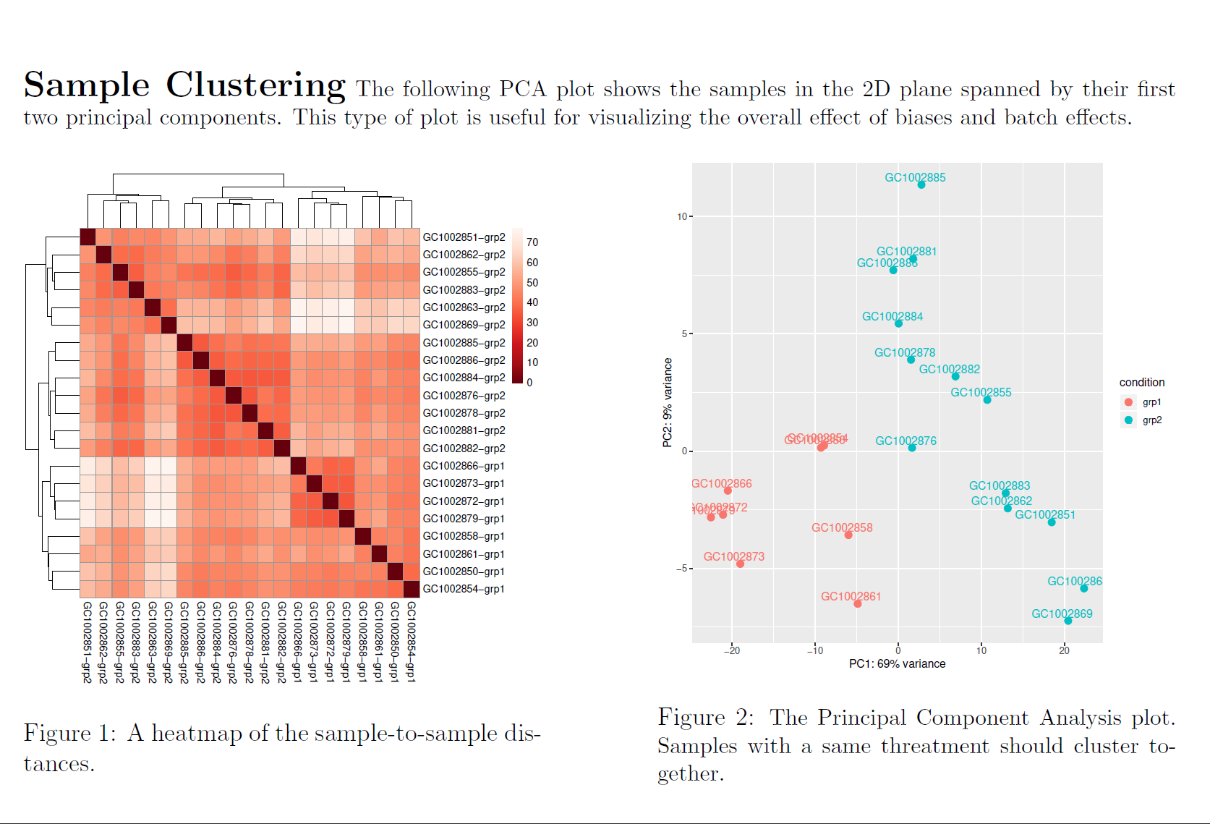
DE Report: Used Reads

Slide 56
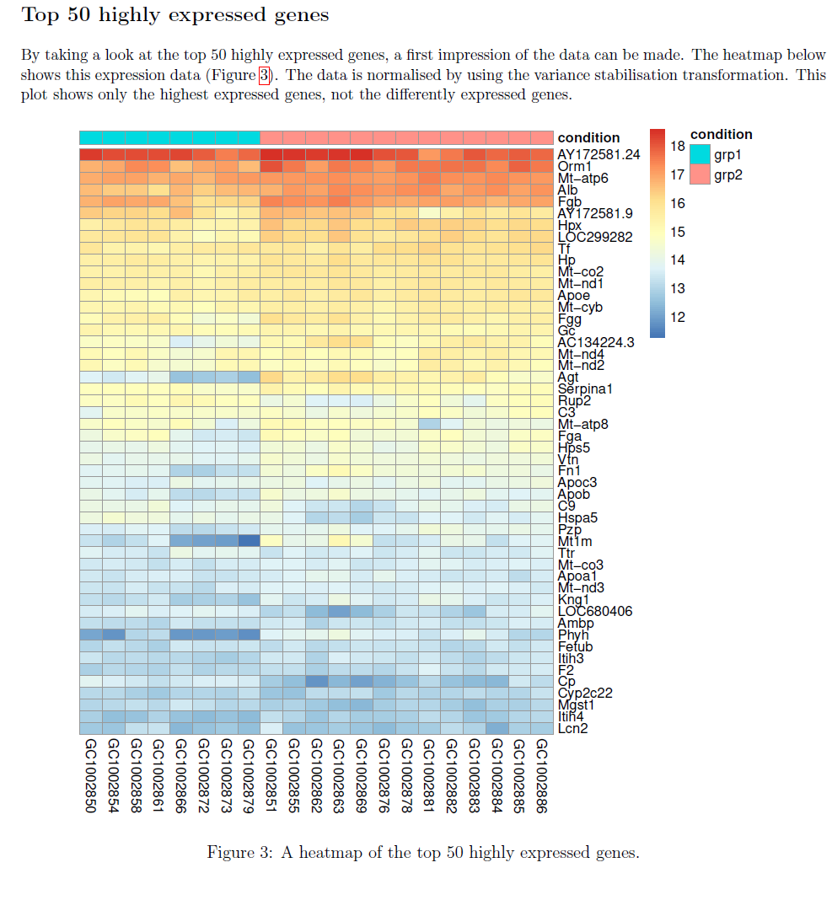
DE Report: Used Reads

Slide 57

Differential Expression Table (DeSeq)

Slide 58
RNASeq is more than DE only
Analysis of fusion genes
Alternative splicing (Pacbio)
Expression miRNA and lncRNA
Cell velocity (single cell)
De novo Assembly

Slide 59
Thanks!

